Slide 1
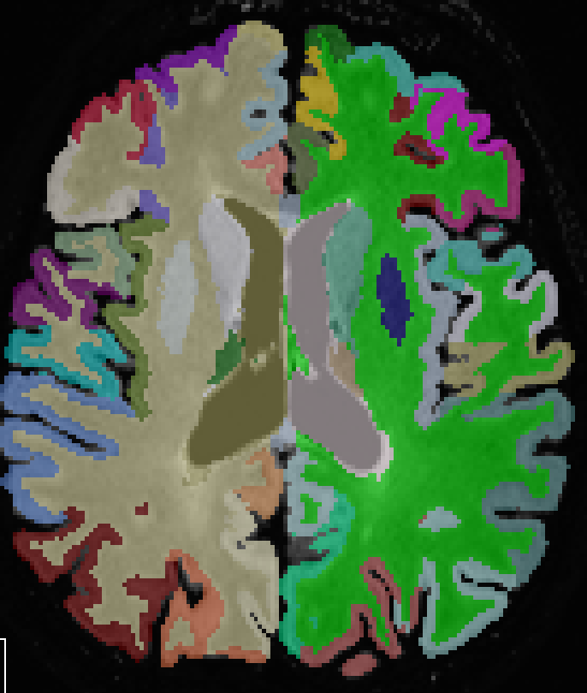
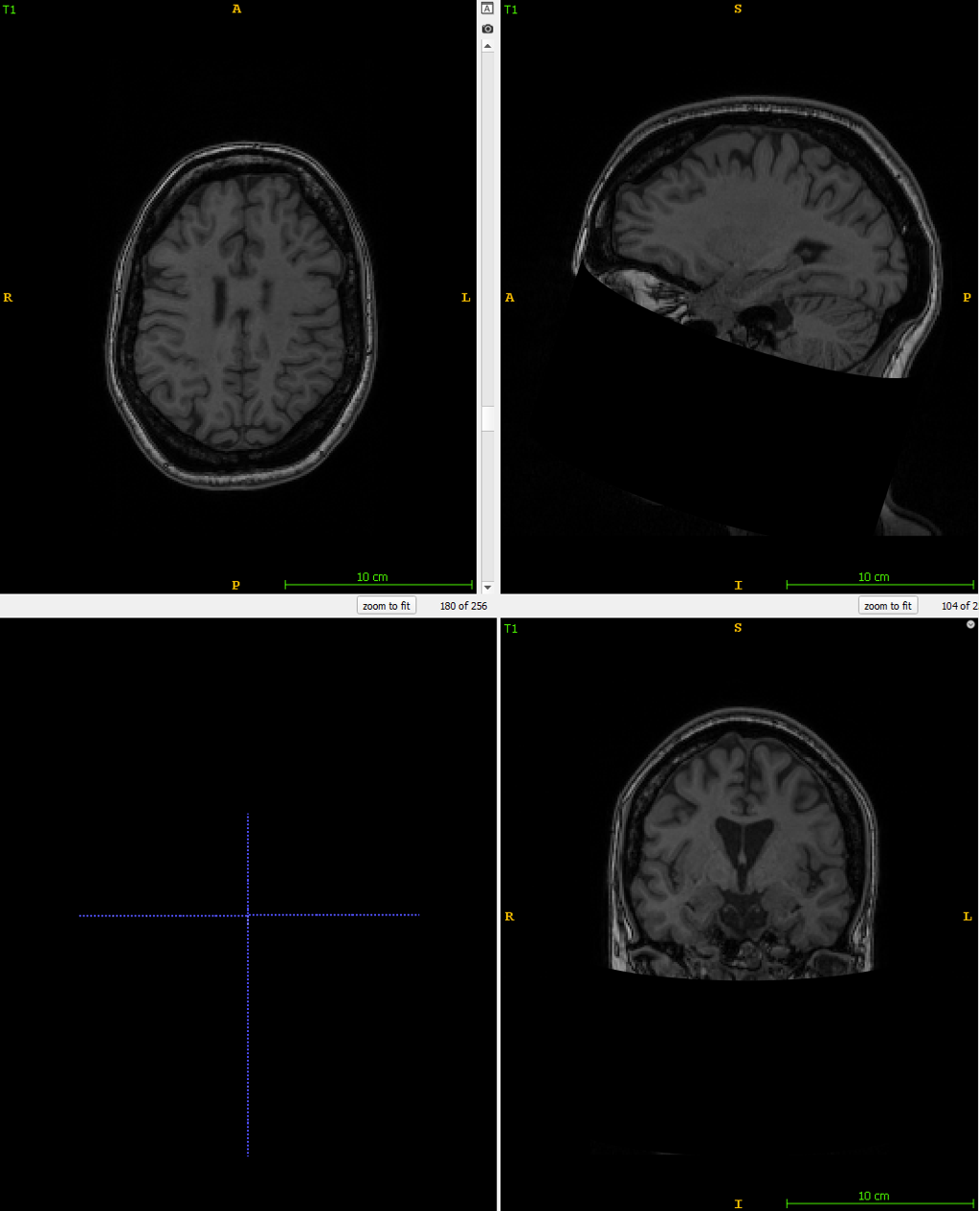
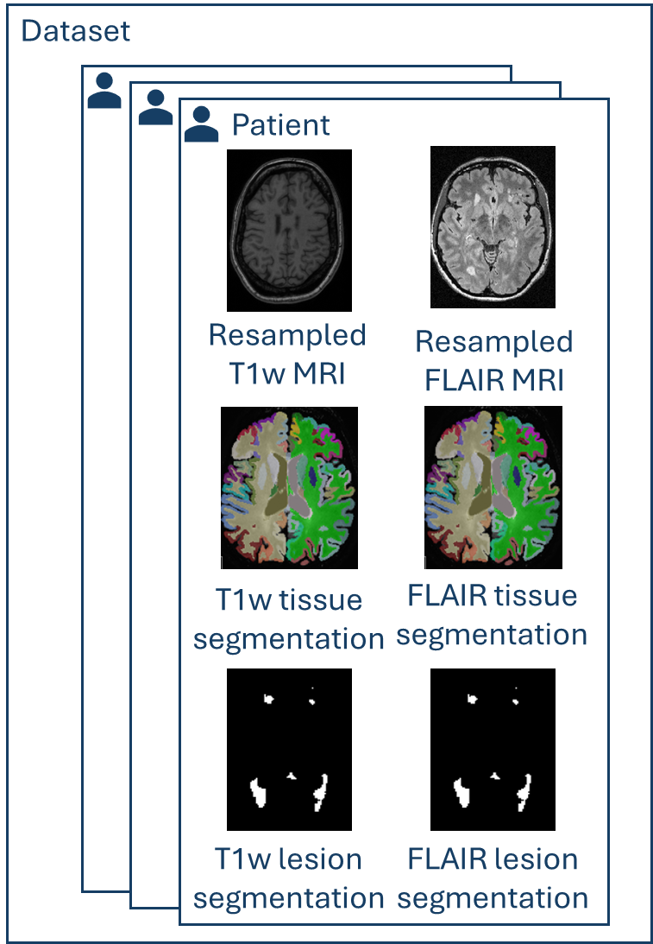
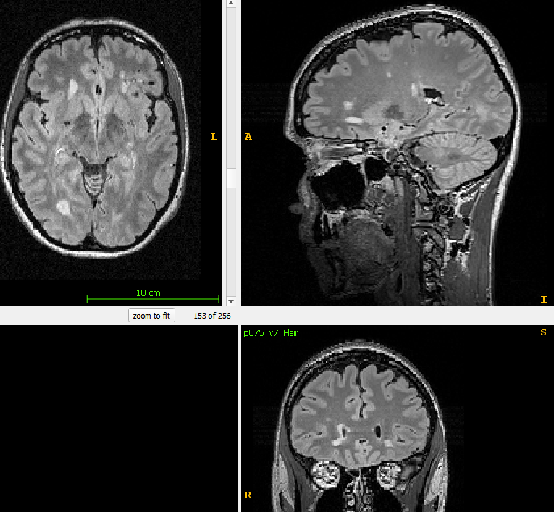
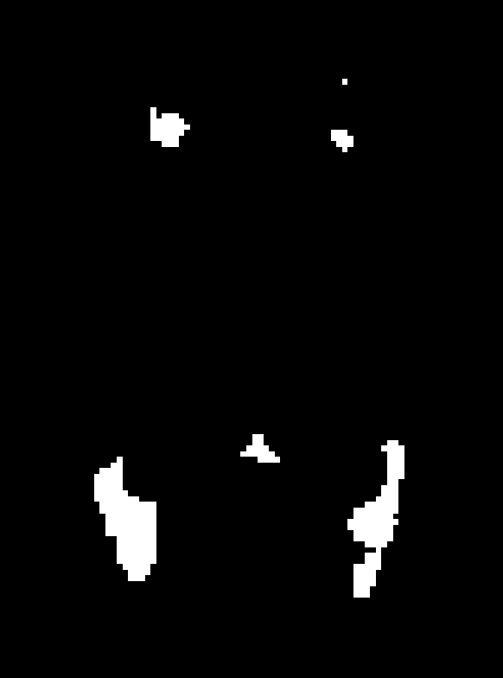
Tissue segmentation
DL+DiReCT
Registration
NiftyReg
T1w tissue segmentation
FLAIR tissue segmentation
Resampling
NiBabel
T1w MRI
Resampled
T1w MRI
FLAIR MRI
Resampled
FLAIR MRI
Lesion segmentation
DeepSCAN
Registration
NiftyReg
FLAIR lesion segmentation
T1w lesion segmentation

Slide 2

Dataset
Patient
Resampled
T1w MRI
Resampled
FLAIR MRI
T1w tissue segmentation
FLAIR tissue segmentation
T1w lesion segmentation
FLAIR lesion segmentation

Slide 3


Timestep t
Noise scheduler
Sampled noise
Noisy image at time t
Voiding image
Diffusion model
Image
Voided image
Predicted Noise
Random mask
sampler
MSE loss
Lesion mask
Mask
Sampled noise
MSE
Circle mask

Slide 4
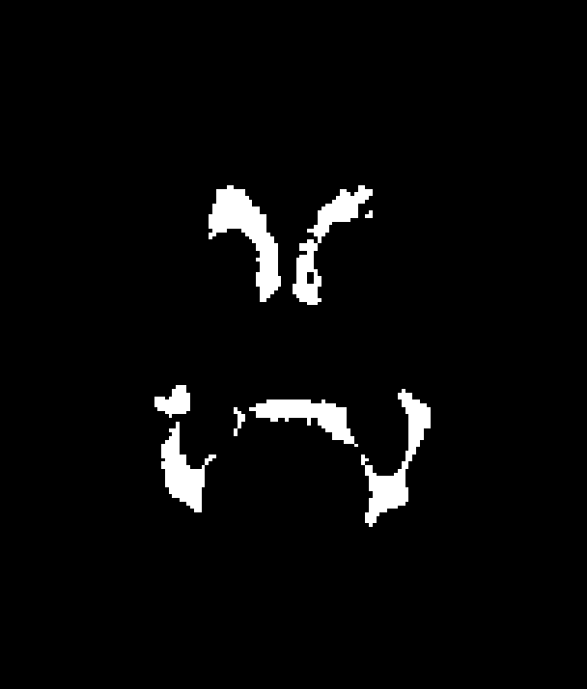
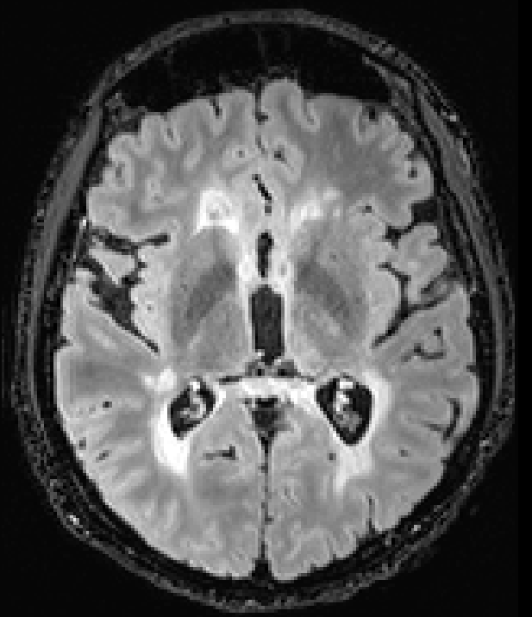


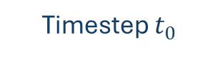
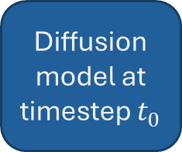
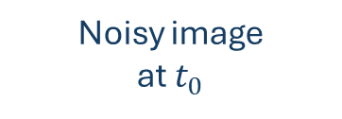
Timestep $t_{0}$
Get lesion
intensity
Lesion intensity
Lesion mask
Noise scheduler
Diffusion model at timestep $t_{0}$
Add coarse lesion
FLAIR
FLAIR with coarse lesion
Noisy image at $t_{0}$
New lesion mask
Sampled noise
FLAIR with realistic lesion

Slide 5
Input Features
Group Norm
Group Norm
2D Conv
Vector Addition and scaling
Timestep t
SiLU
SiLU
SiLU
(Optional) Pseudo-3D Conv
Output Features
2D Conv
Linear
Dropout
(Optional)Pseudo-3D Conv
Vector Addition
Notes:
After Lienar Layer is a Unsqueeze

Slide 6
Rearrange (b) c h w -> (h w) c b
1D Conv
Rearrange (h w) c b -> (b) c h w
Input Features
Output Features

Slide 7
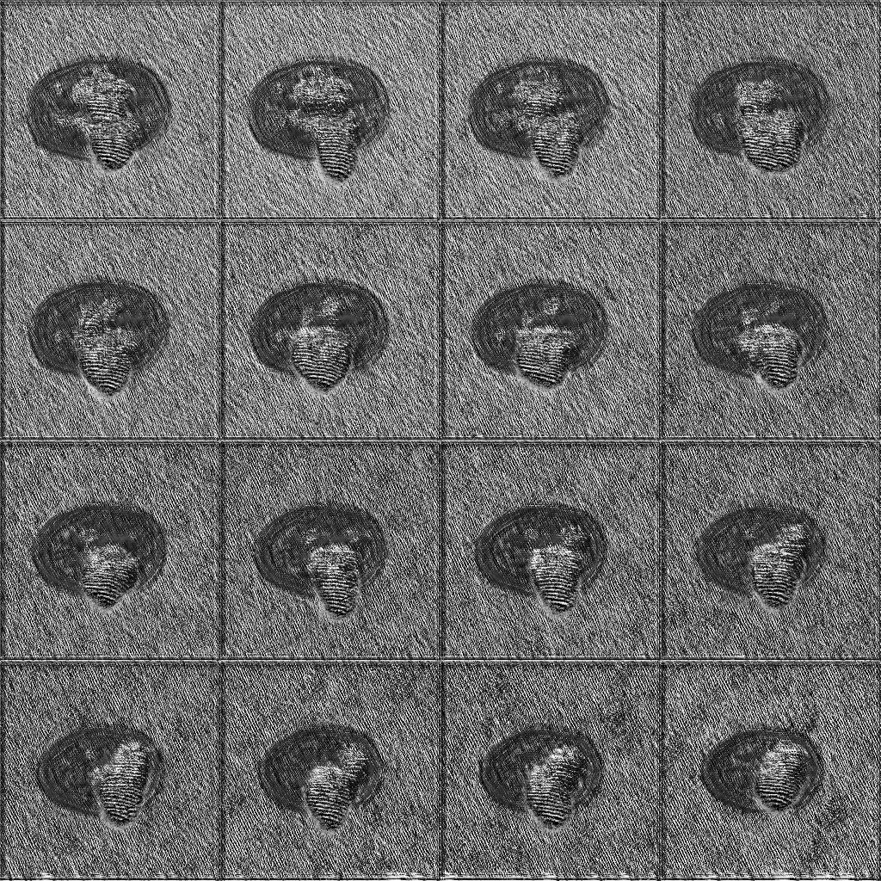
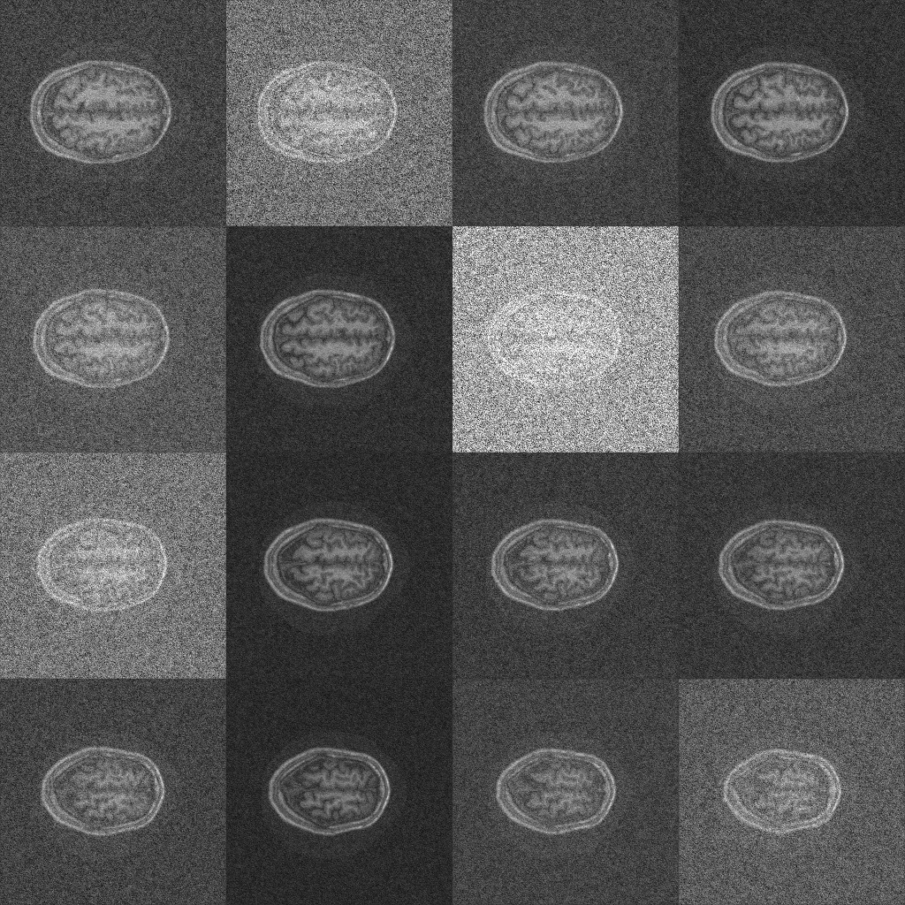
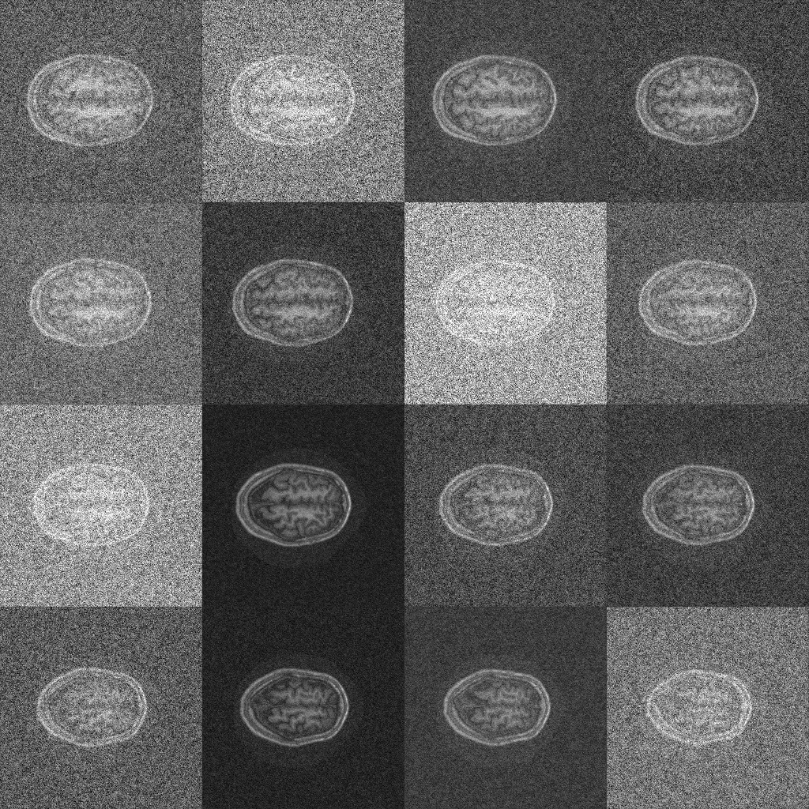
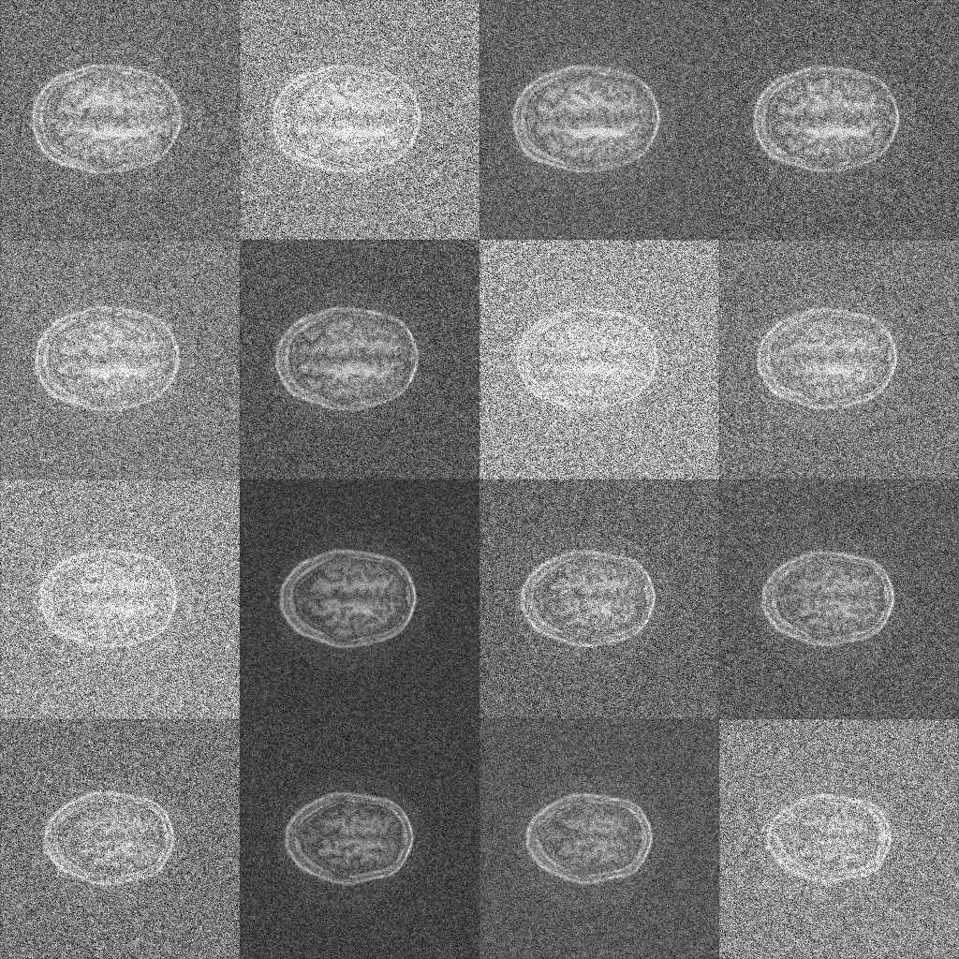
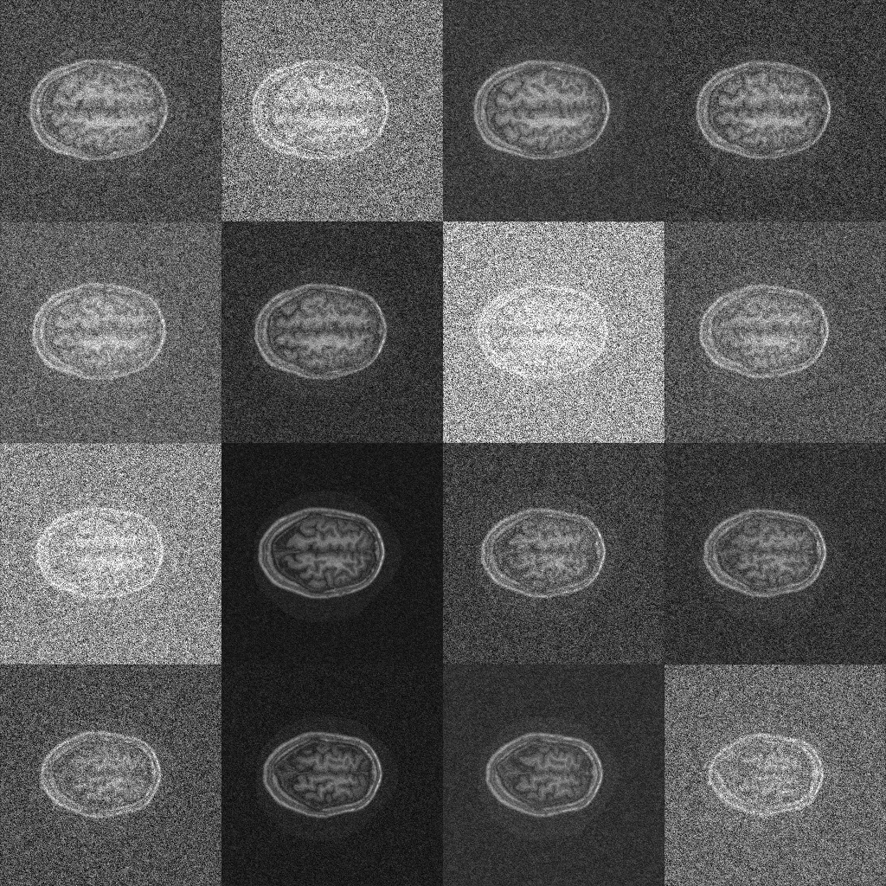
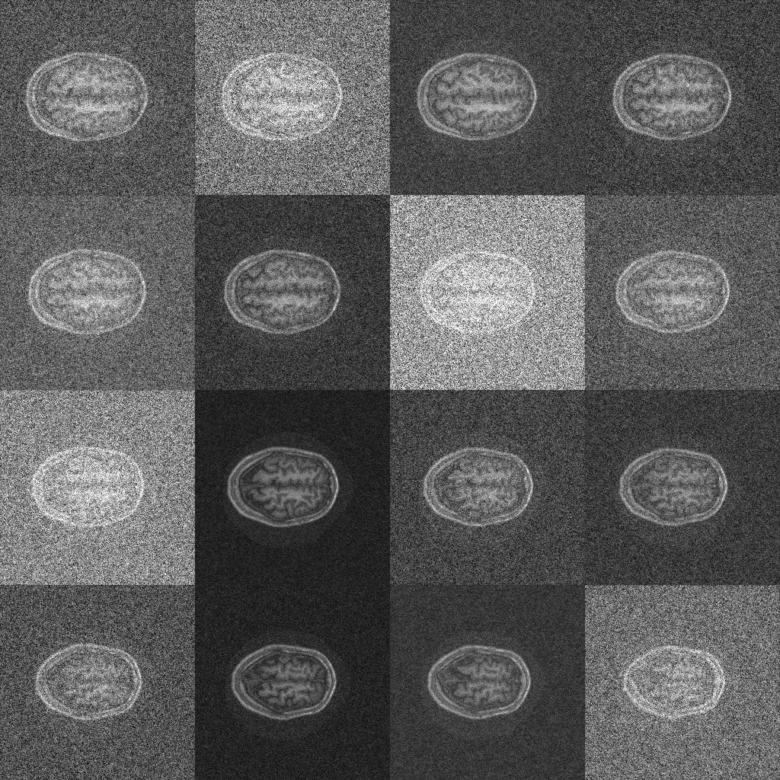
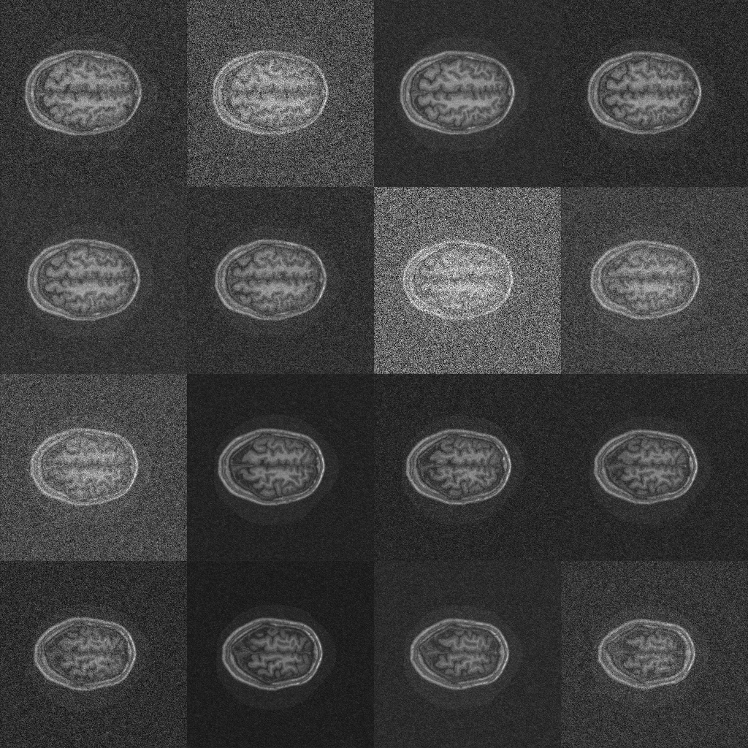
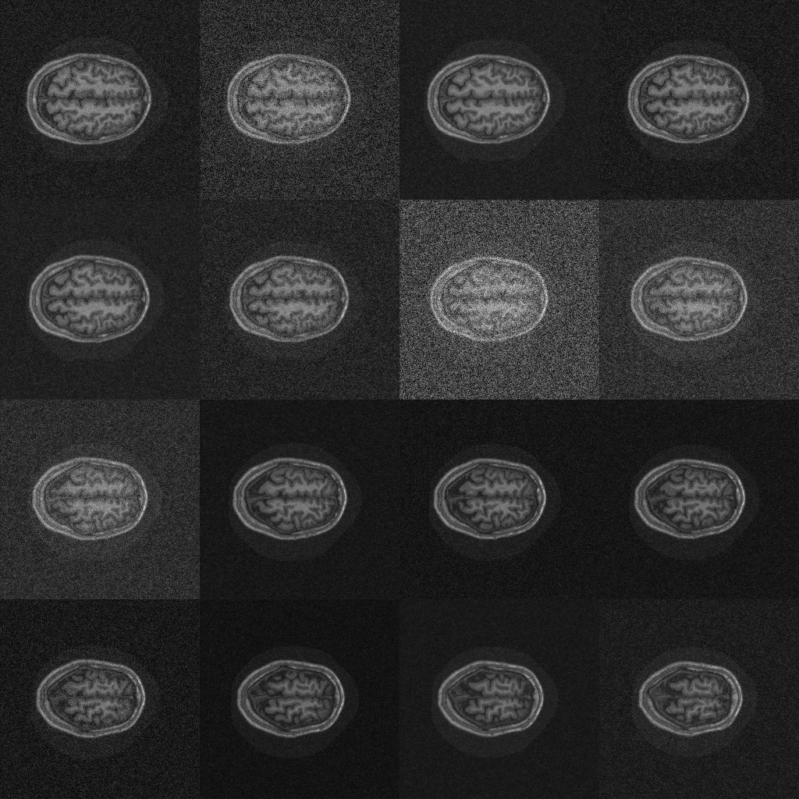
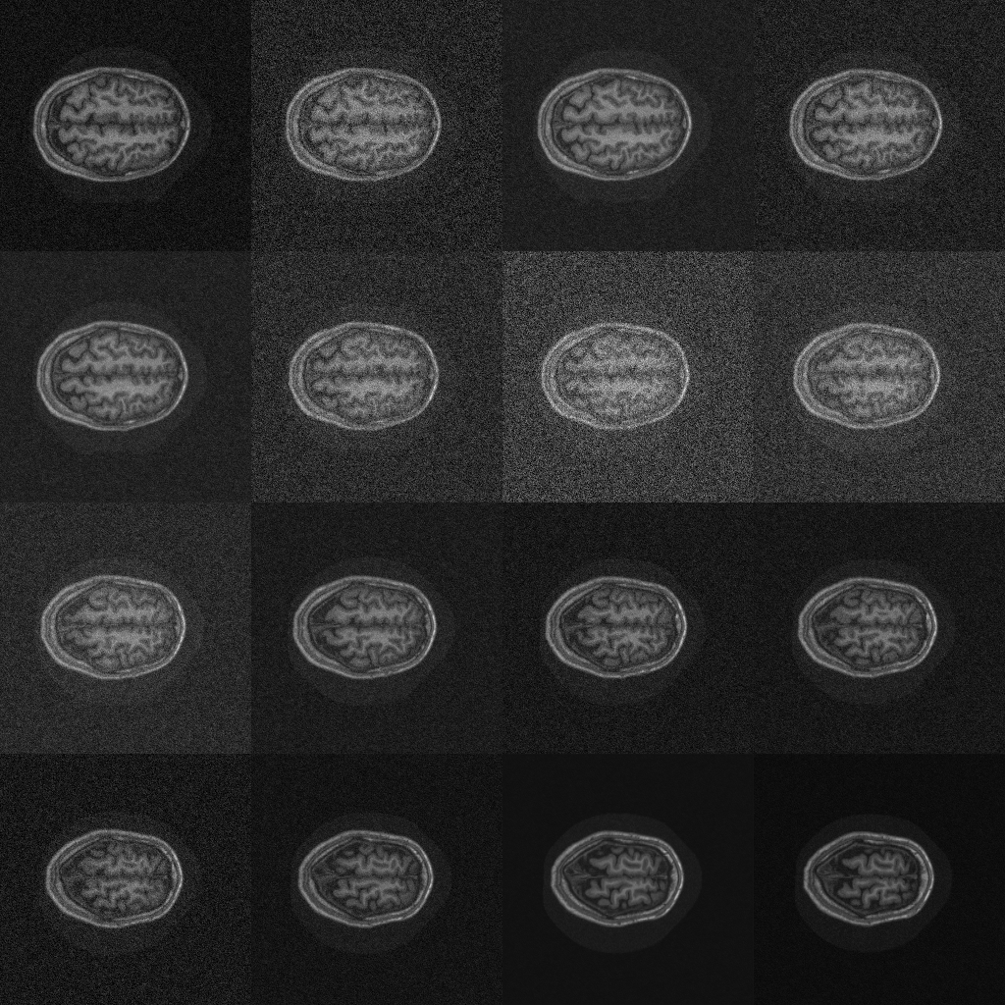
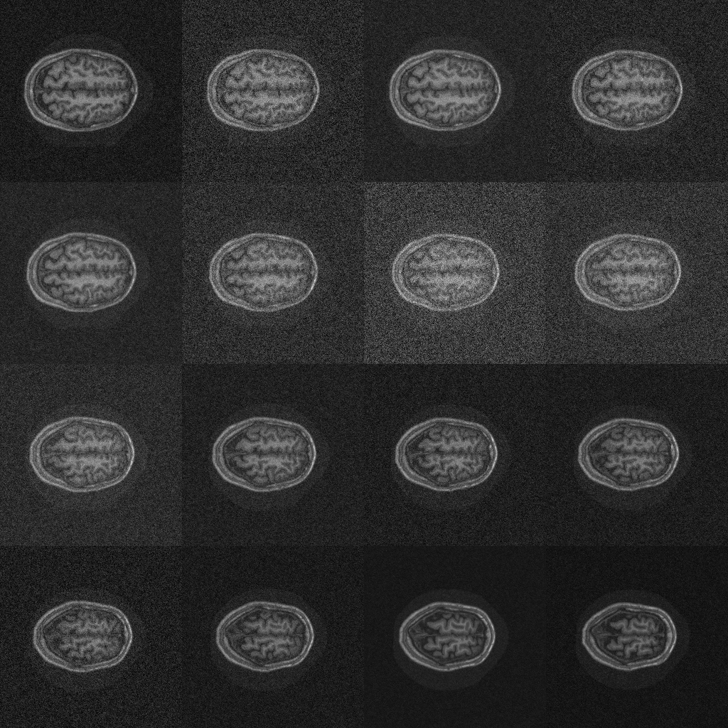
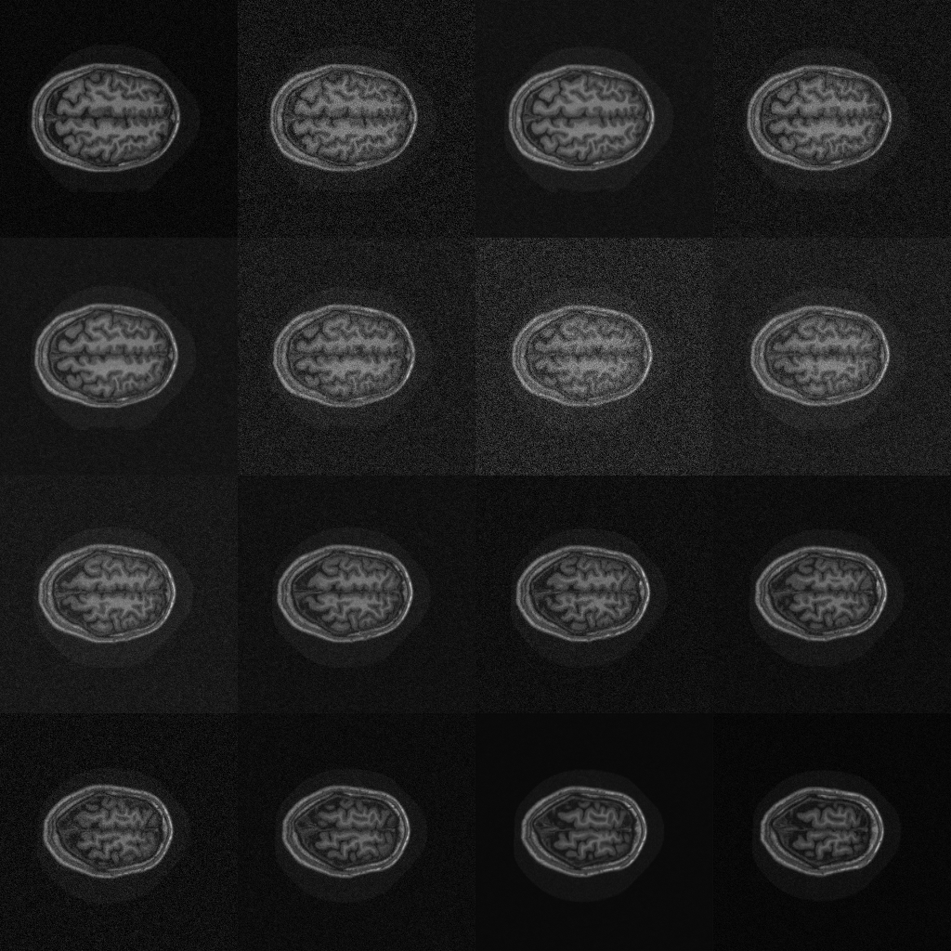
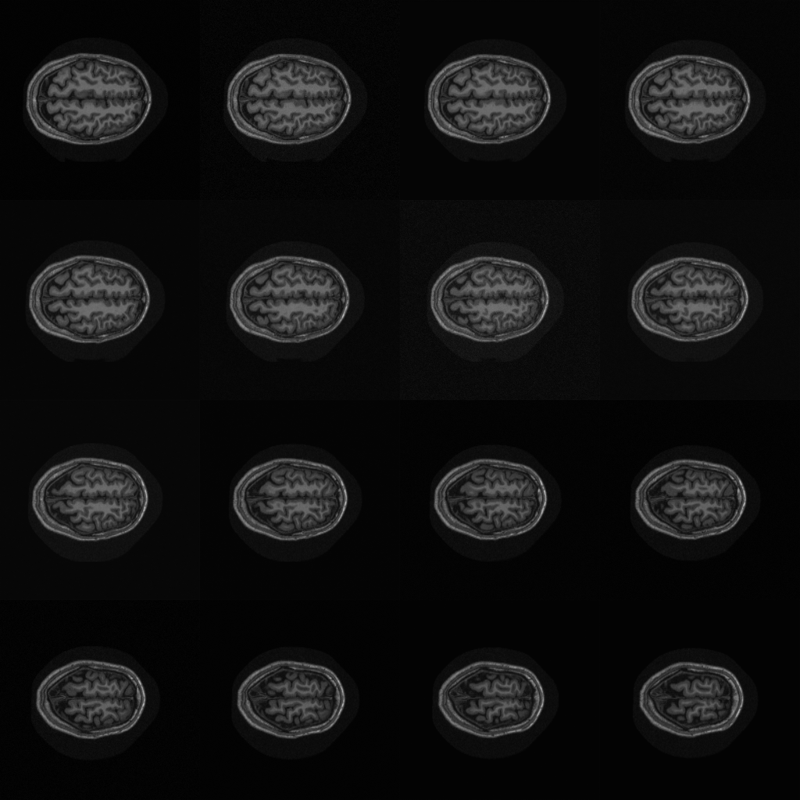
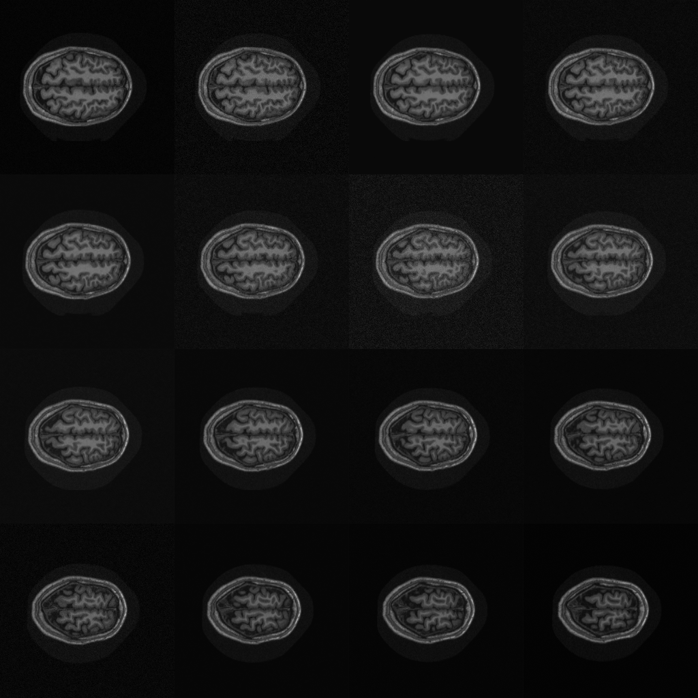
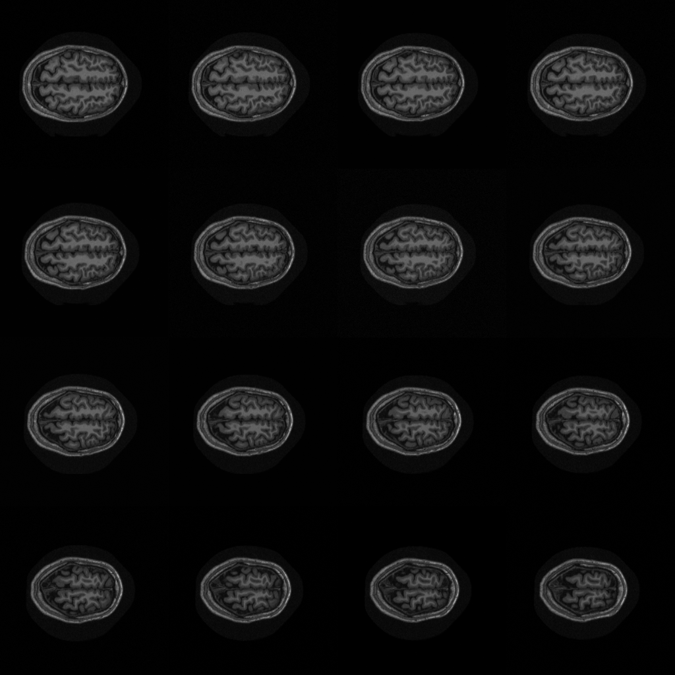
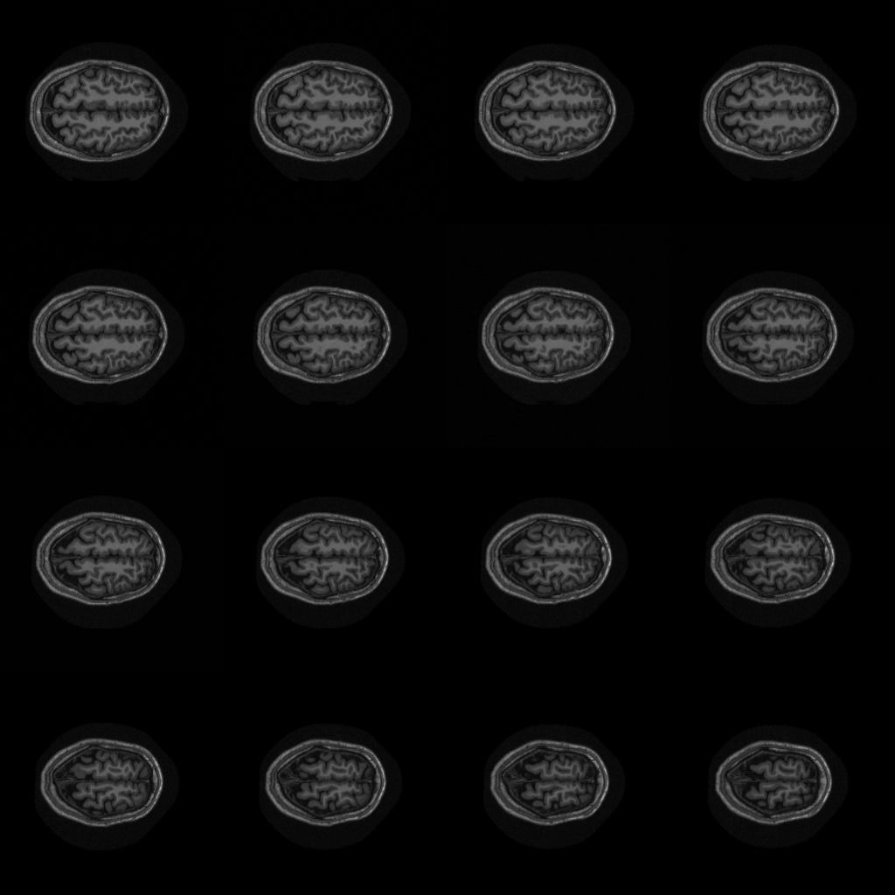
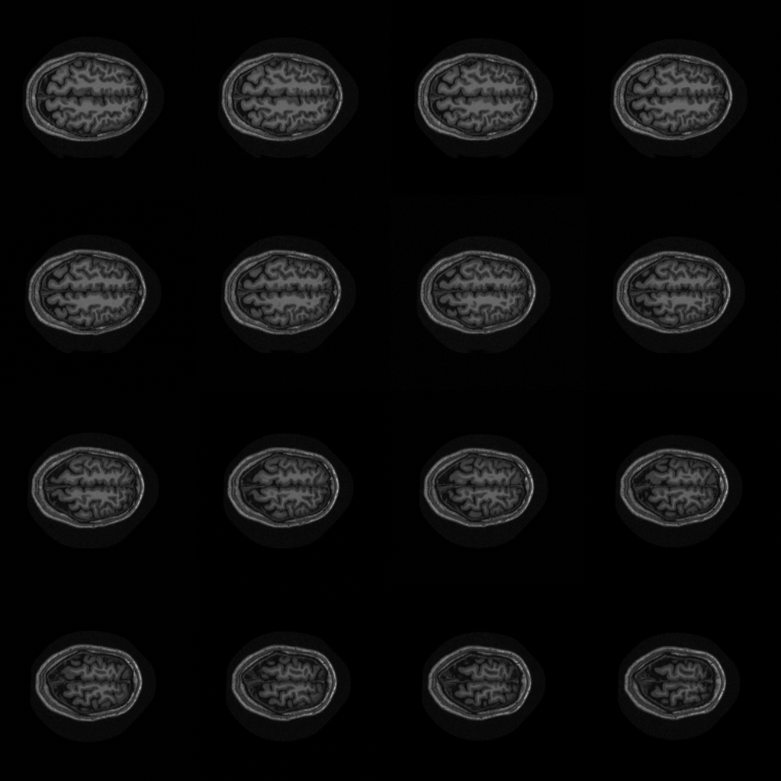

Slide 8

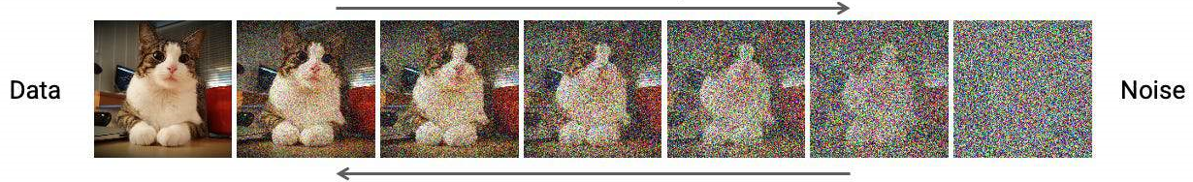
Data
Noise

Slide 9
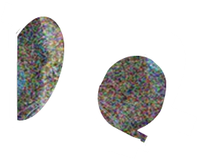

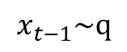
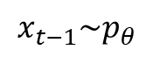
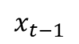
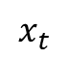
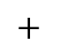

Input
$$x_{t−1}\sim q$$
Mask
Noise
$$∗$$
$$x_{t−1}$$
$$x_{t}$$
$$x_{t−1}\sim p_{θ}$$
Mask Inv.
$$+$$
Denoise
$$∗$$
Next iteration

Slide 10
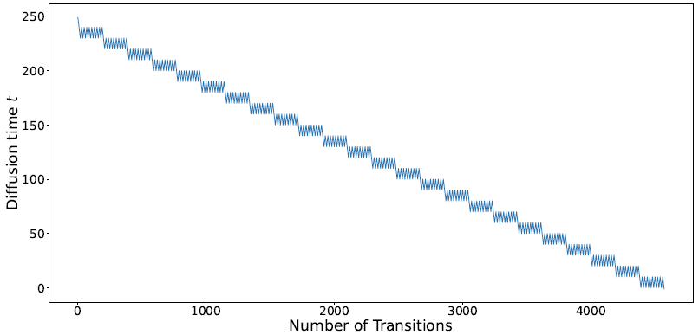
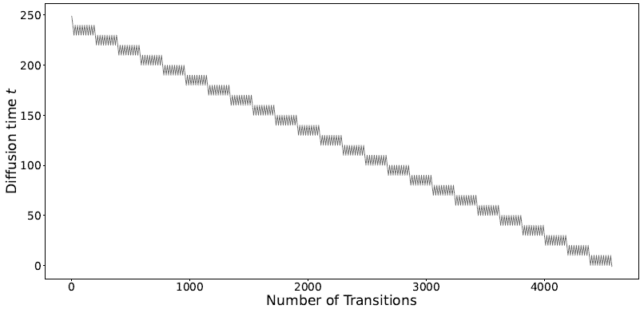
Diffusion time t
Number of Transitions

Slide 11
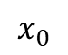
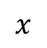
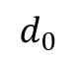
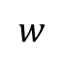
Multiply
L2 norm
Spatial Average
Normalize
Subtract
Avg
F
F
$$d_{0}$$
$$x$$
$$x_{0}$$
$$w$$

